Slide 1

INTRODUCTION TO BASIC ELECTRONICS

Slide 2
What problem did you solve?
Did it involve any use of technology ?
Notes:
Talk about the connect between Design thinking and Electronics. After we get ideas we need to implement , for that we need the use of technology. And that is why it is there in respective ATL’s.

Slide 3

Let’s start with an activity
Notes:
The paper circuit activity. Tell them to explore the materials they have and make something.

Slide 4
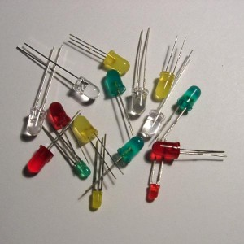
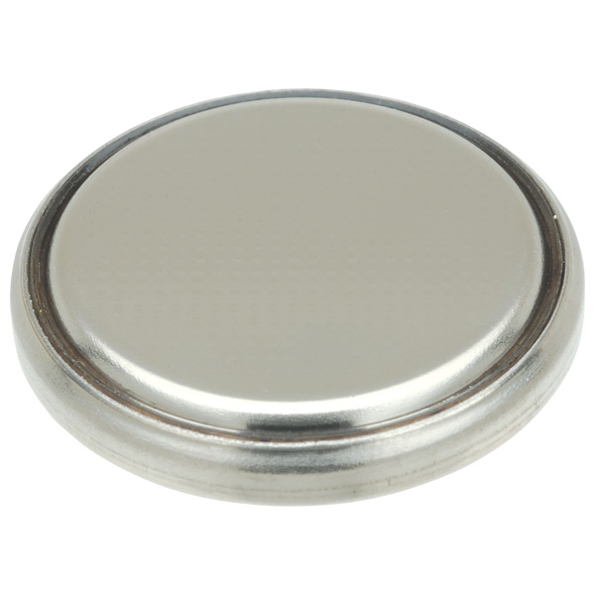
Materials you have
LED’s Coin Cell
Notes:
Let them explore it by themselves and make sure that they are doing it. Give them 30 minutes to do so.

Slide 5
What did you make ?
Notes:
Ask them about what they did. Who all succeeded in lighting an LED and who did not. Those who made what did they actually do.
Ice breaking activity:
Ask for 3 volunteer to come on stage and allocate them names : BULB, Battery And Switch and tell them to hold hands and show what actually happened.

Slide 6
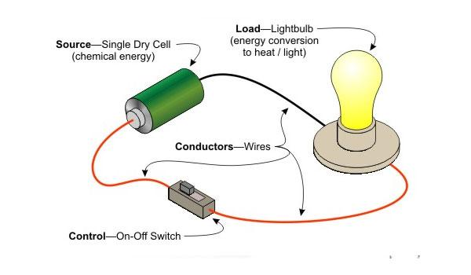
WOW! You made a circuit
Notes:
Explain what a circuit is and how they accidentally made a circuit.
Circuit is the most basic part of the electronics and you learnt it. Examples of few circuits around ourselves. Tell them about open and closed circuits.

Slide 7
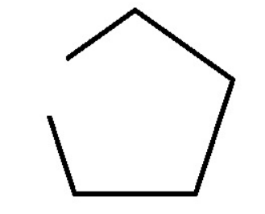
Can you calculate the area of this figure?
Notes:
Explain what a circuit is and how they accidentally made a circuit.
Circuit is the most basic part of the electronics and you learnt it. Examples of few circuits around ourselves. Tell them about open and closed circuits.

Slide 8
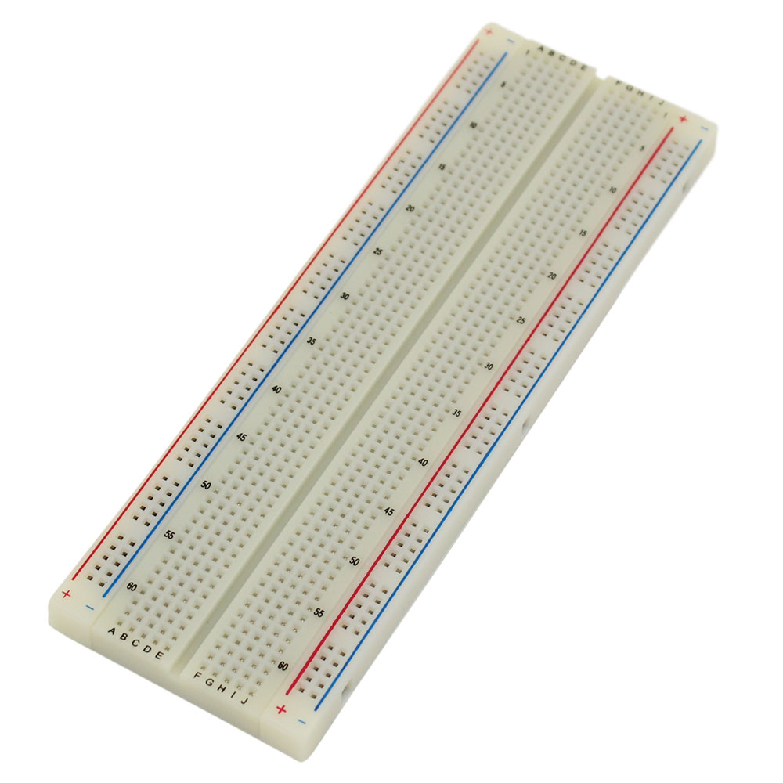
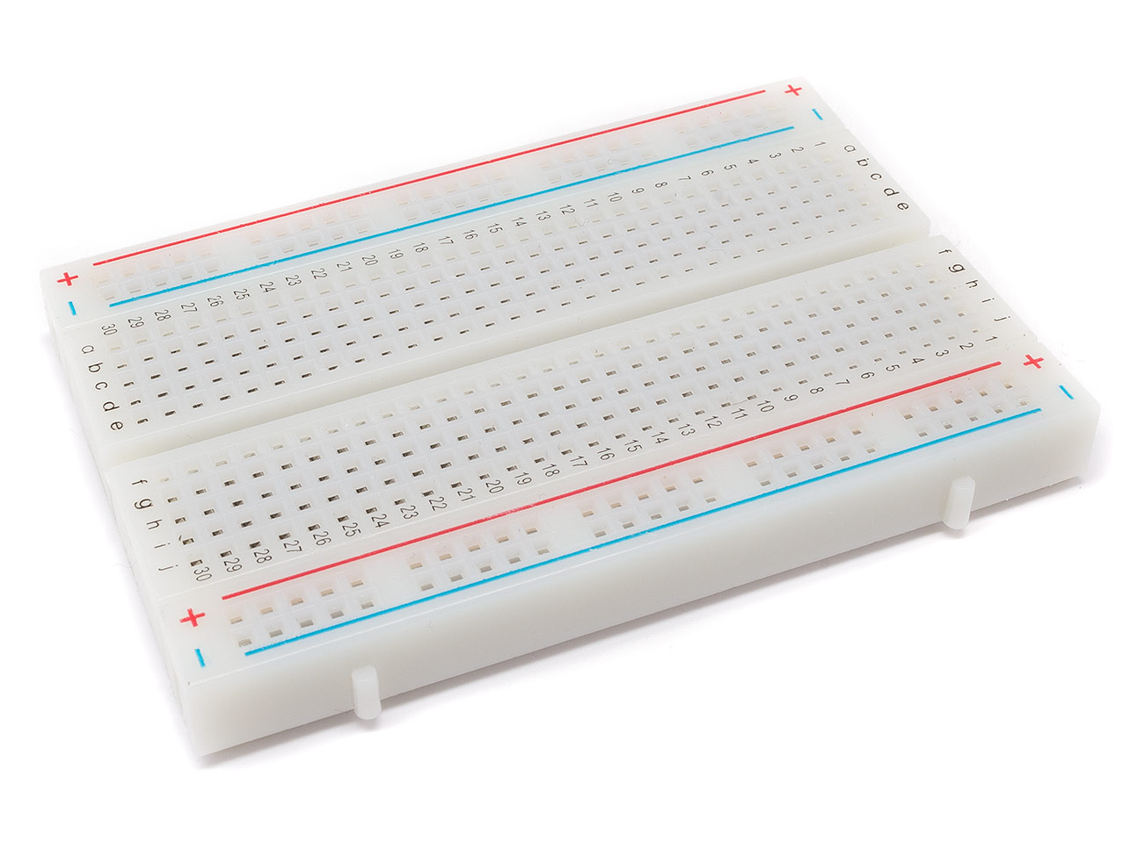
Breadboard
Notes:
You just made a simple circuit and to solve problems we need to make complex circuits and make multiple connections.
Show Physical Breadboard :
Tell them to explore about the breadboard and try to connect multiple Led’s.
Give them 15 minutes to do so.
Question to audience:
What they did and how many were able to light up multiple LED.

Slide 9
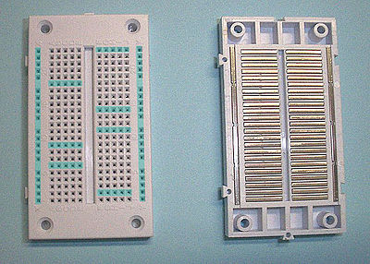
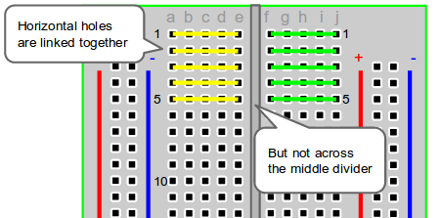
Connections in a Breadboard
Notes:
Explain about the breadboard and its connection.

Slide 10
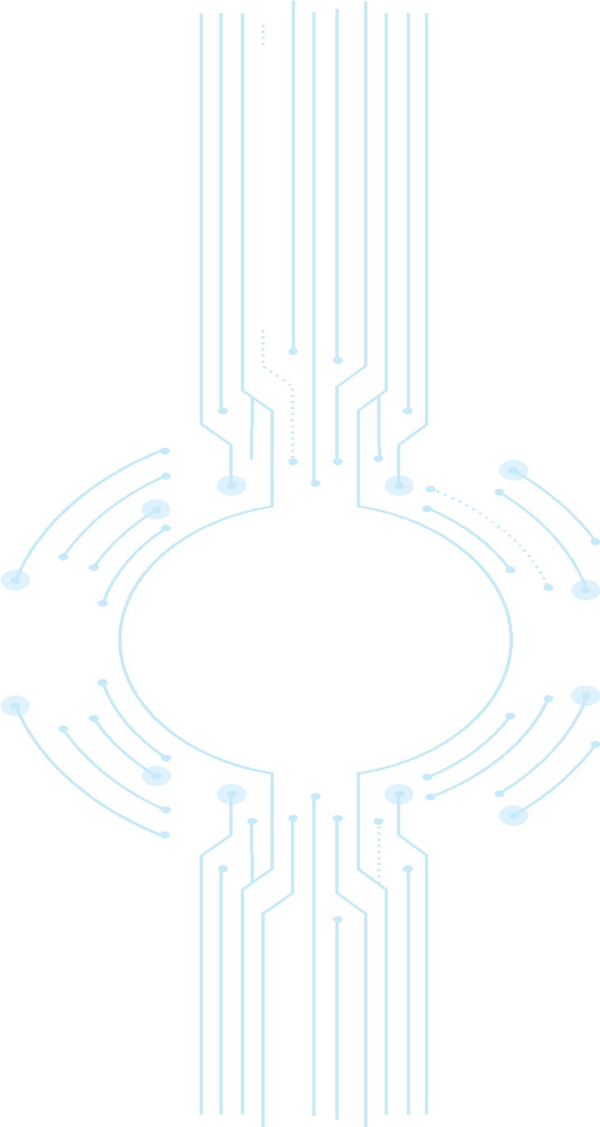
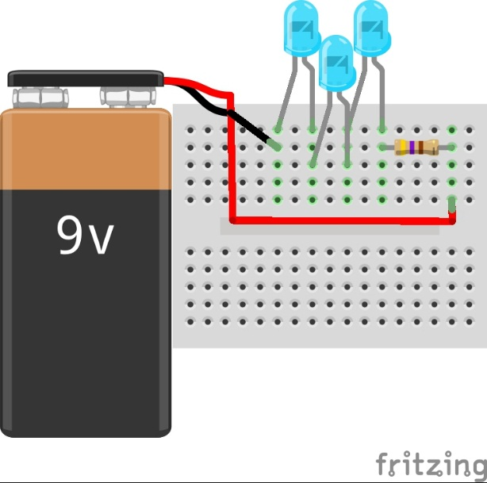
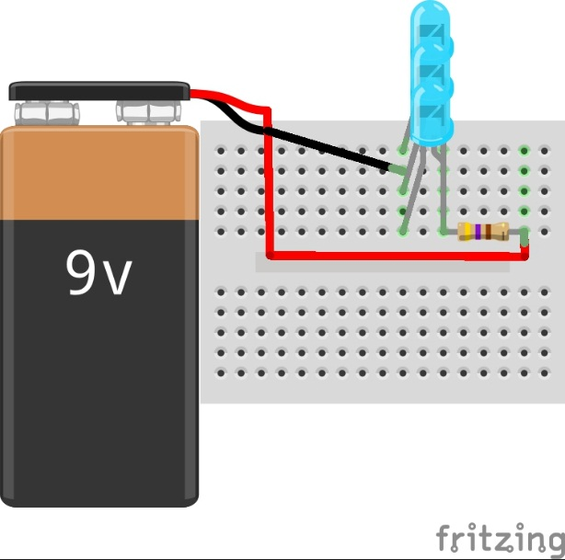
Connection Types
Series
Parallel
3 LEDs are connected in series along with a resistor with 9V power supply
3 LEDs are connected in parallel along with a series resistor with 9V power supply

Slide 11
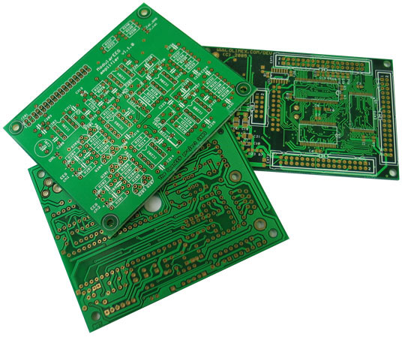
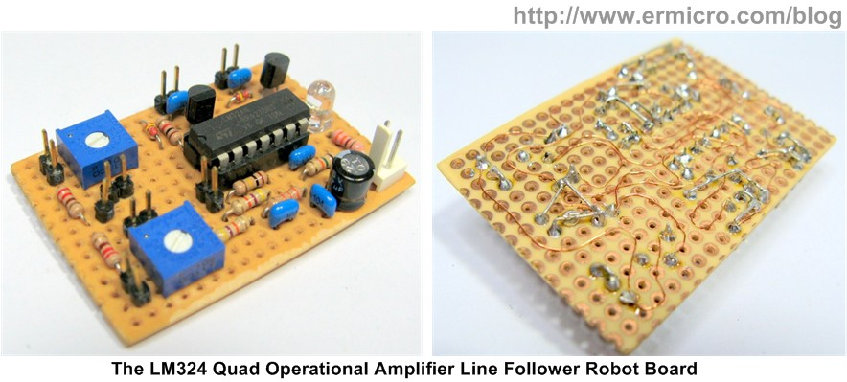
Further forms of circuits
Notes:
this is the next version of circuits we make after breadboard version
will last longer then breadboard
will need soldering
cost effective

Slide 12
THANK YOU!!!

